Slide 1


Greeshma Gopinathan
Jagruta Advani
Dhruv Arora
Gayathree Gopi
Tara Mary Joseph
John Hwang
Analytics for Unstructured Data
Fall 2024
NASA and ISRO
Exploring space public opinion

Slide 2
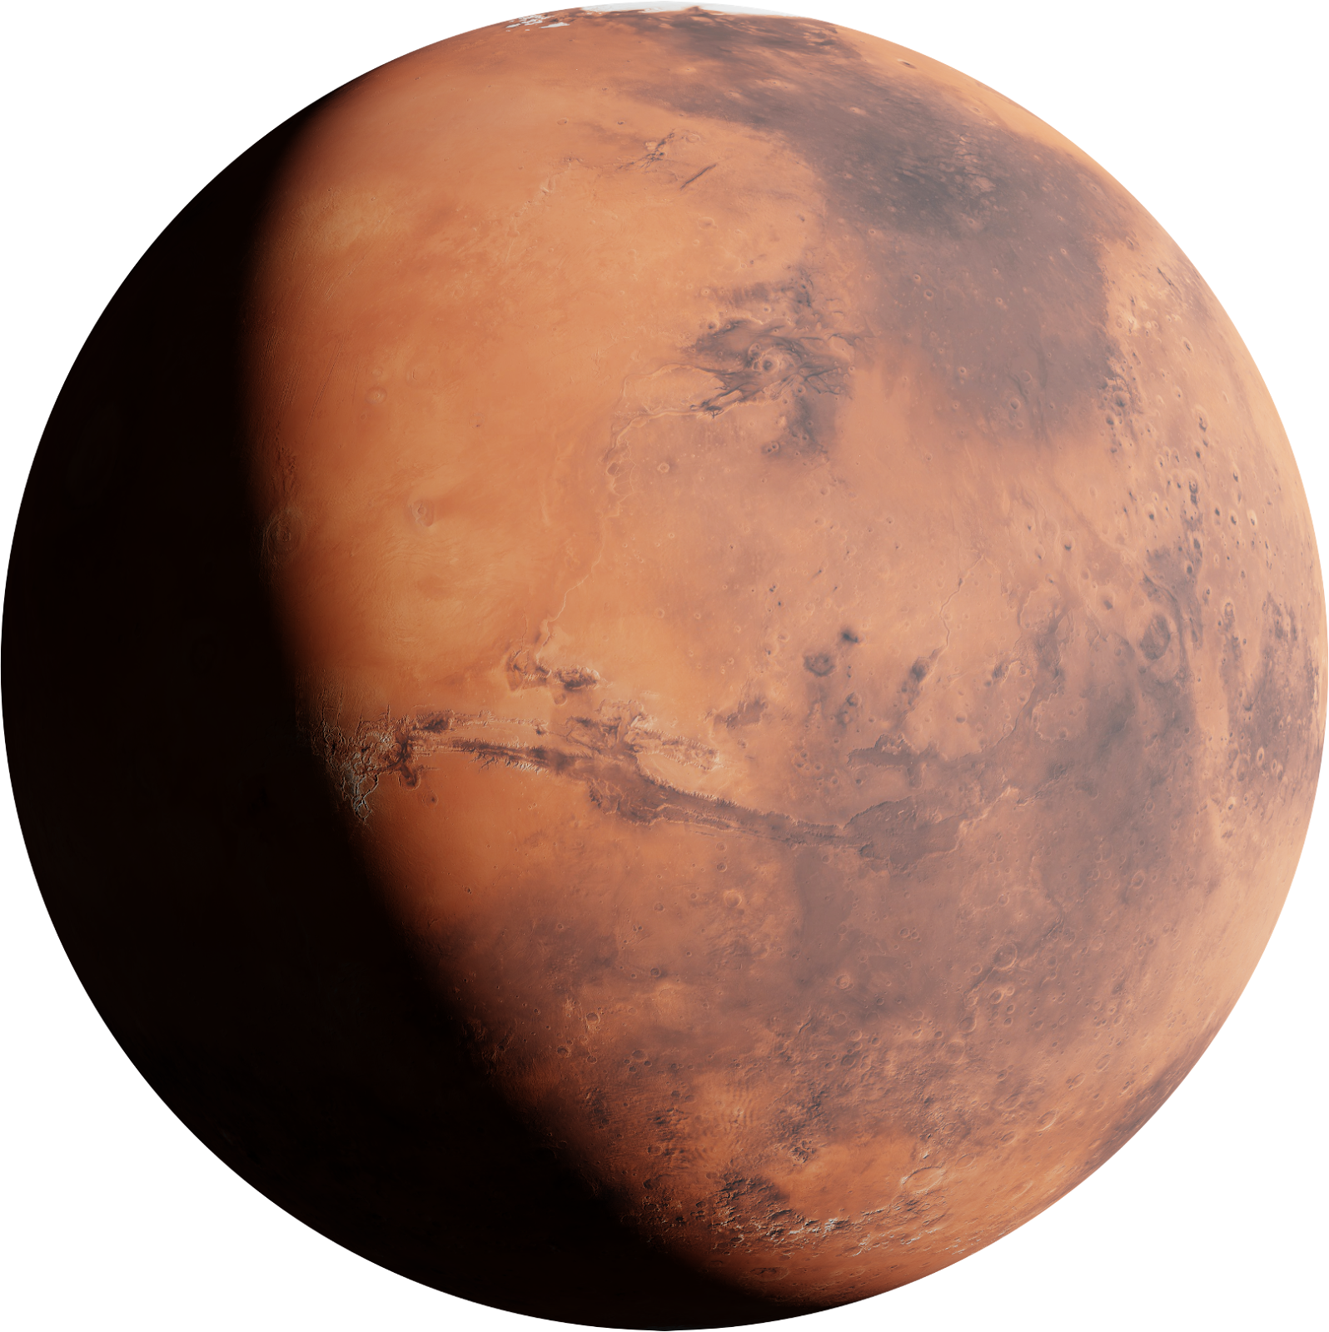

Why NASA vs. ISRO
Importance of the topic
Technological Innovation vs. Cost-Effectiveness:
NASA excels in advanced technology and deep space missions, while ISRO focuses on affordable, efficient missions.
Impact and Strategic Priorities:
NASA emphasizes scientific exploration and space tourism, whereas ISRO prioritizes national development, satellite services, and cost-effective space exploration.
Notes:
-NASA vs. ISRO is a relevant topic for international students and people interested in the latest space news
-ISRO has become famous recently after cost-effective missions such as Chandrayaan and Mangalyaan but its visibility on social media and in public opinion remains comparatively low
-Goal: find recommendations for visibility and analyze in comparison to NASA

Slide 3

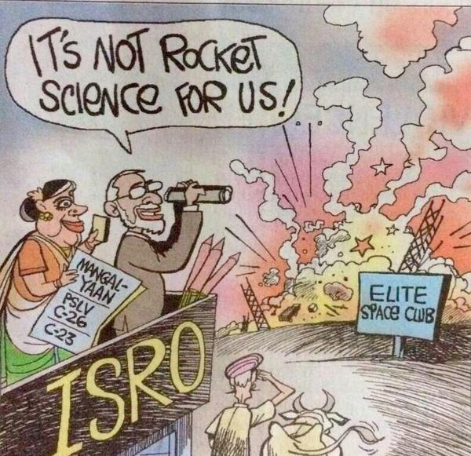
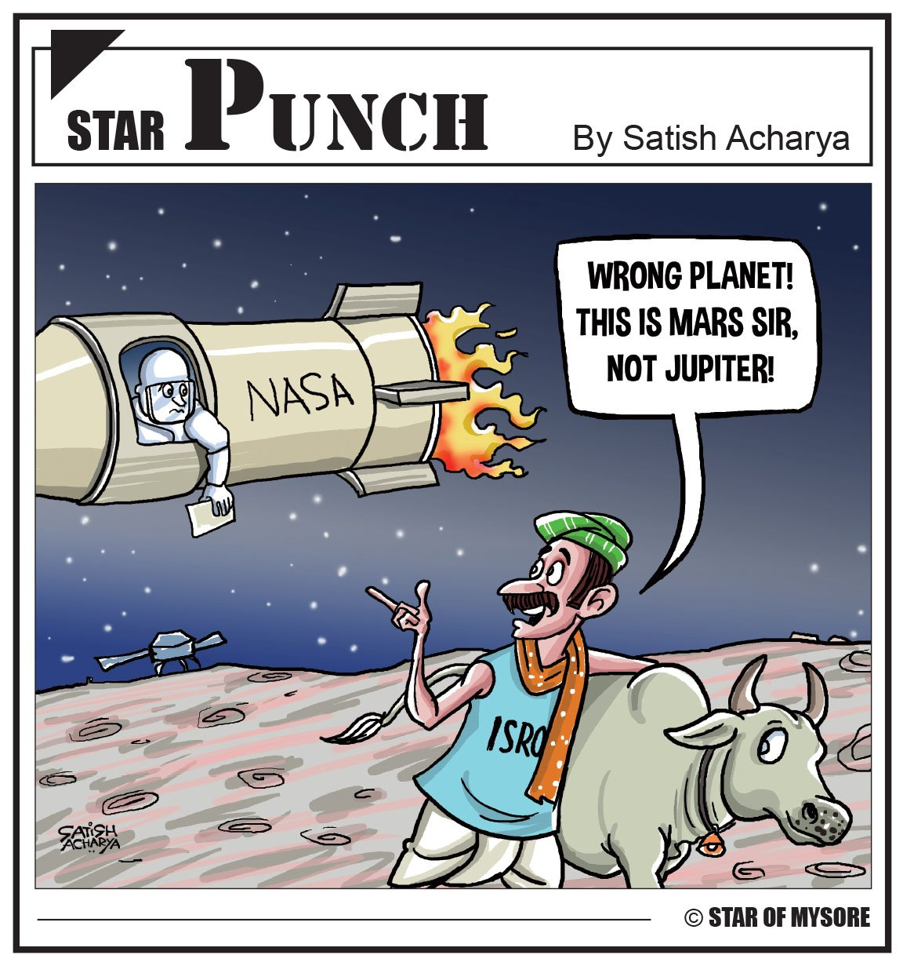
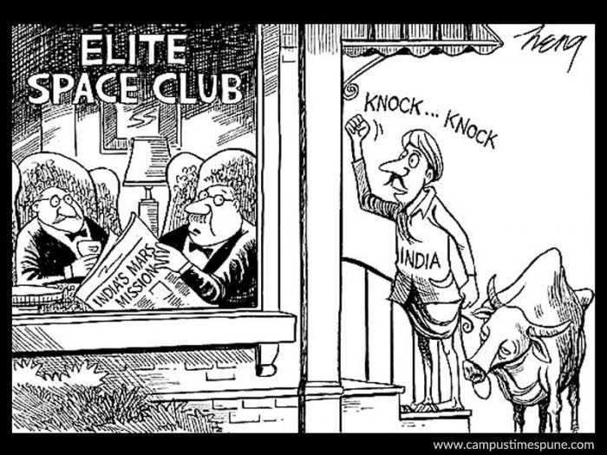
Background
Notes:
-Racism closely associated with Indian space and ISRO’s achievements along with positive public opinion
-Wanted to combat that perception by analyzing the best attributes ISRO can highlight and looking at how many people hold racist opinions about ISRO as well

Slide 4
Scraping Public Sentiment
Reddit:
Scraped posts and comments from relevant subreddits (e.g., r/isro, r/nasa, r/Space) and various relevant posts.
Extracted key themes like public opinions on missions, technologies, budget, and comparative discussions.
Instagram:
Collected posts, captions, like counts for official NASA and ISRO instagram channels and ran image analytics on it.
Analyzed post engagement to gauge public enthusiasm for both agencies using topic modeling.
Notes:
-Scraped around 1000 comments from posts in various subreddits and instagram posts from both NASA and ISRO

Slide 5
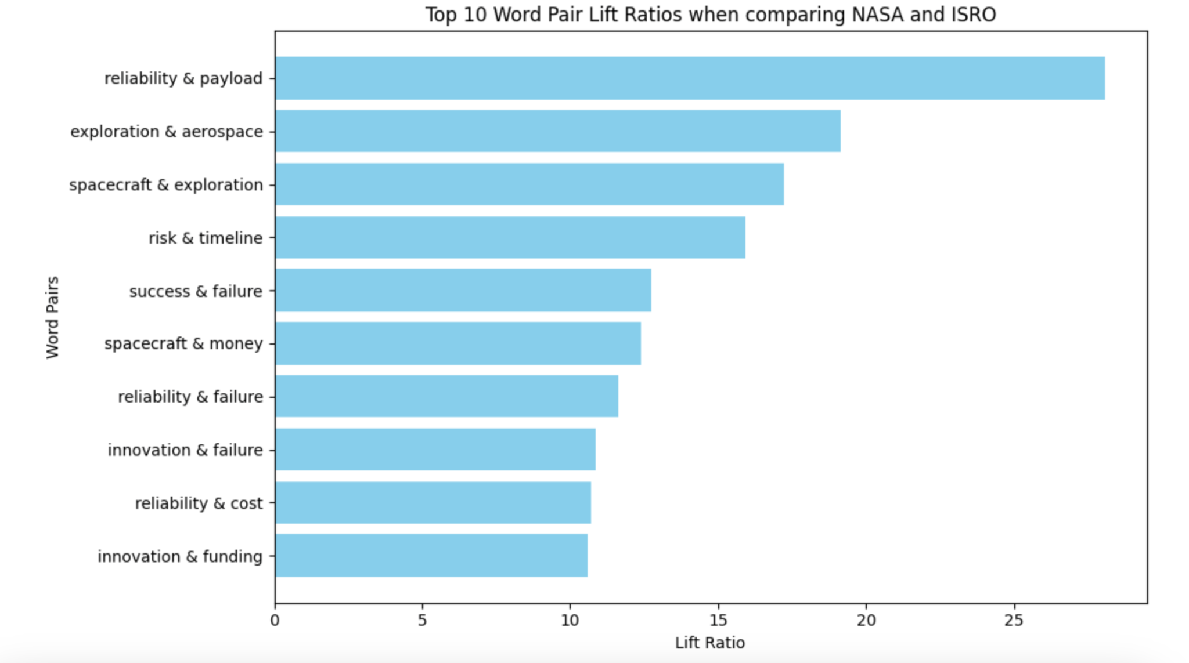
Lift Analysis
Notes:
Top 10 pairs emphasize reliability, payload, exploration

Slide 6
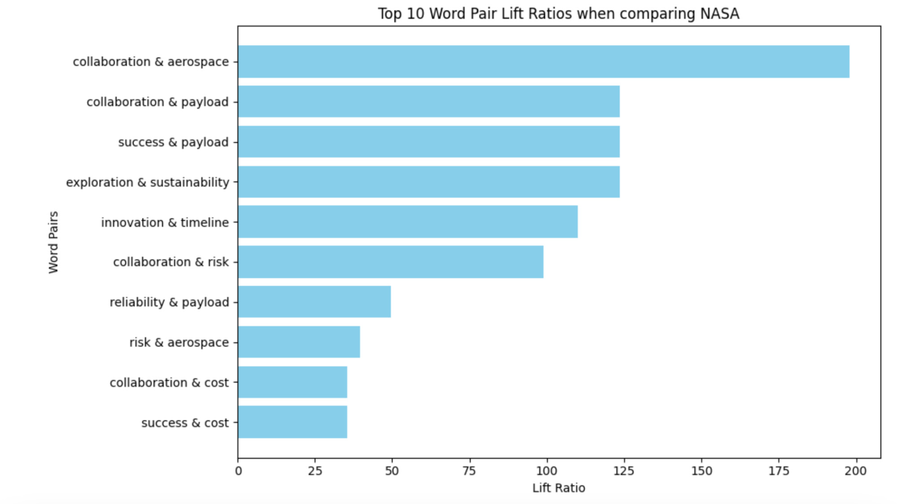
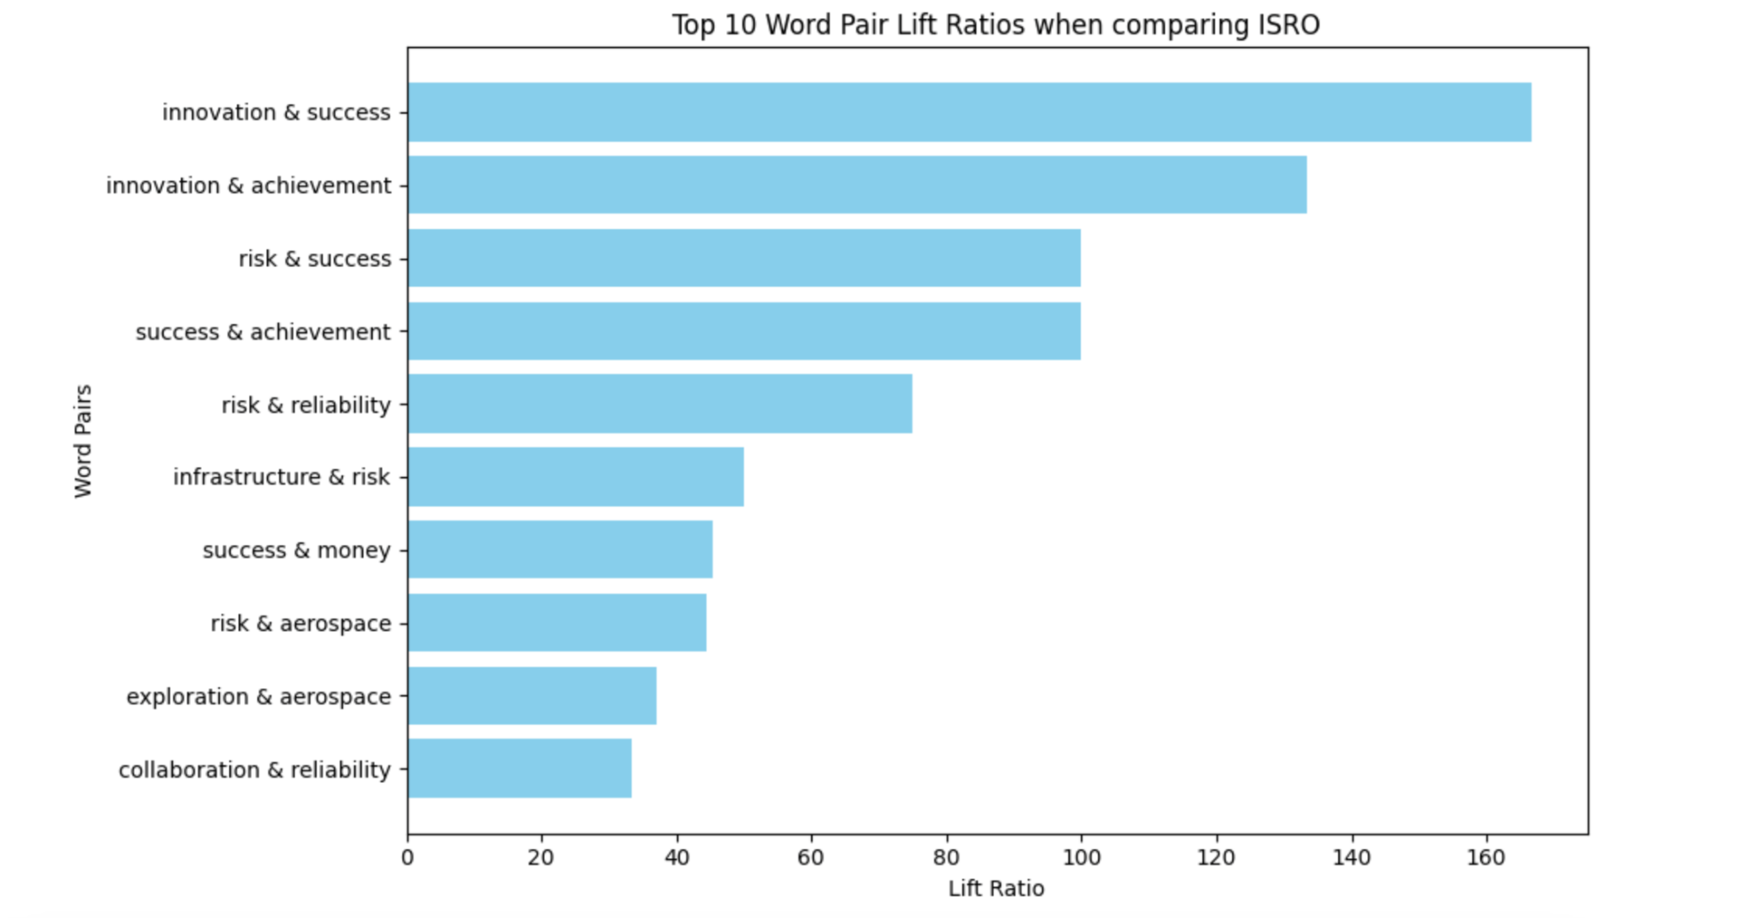
Lift Analysis
Notes:
NASA has emphasis on collaboration, payload, and success, while ISRO has emphasis on innovation, achievement, success, and risk (understandable because it has lower budget and social media presence)

Slide 7
Top Attributes and Associations
For all forums: Reliability and payload
For NASA: Collaboration & Aerospace
For ISRO: Innovation & Success
Notes:
-Lots of posts were associating risk with NASA, and there was ambiguity about how they were spending their budget or funding their projects. This was an interesting insight given that NASA is so well-known
-Ppl were attaching innovation to ISRO which is a good indicator despite NASA being so well-known
Before defining the attributes to look at, we analyzed the frequency counts of all words. Then, we defined the following words such as rover, moon, technology to perform a lift analysis.
For this process: we determined specific words from the frequency counts table and determined if they could provide important insight to the data
We then added context specific words such as “budget” and “cost” based on our knowledge about ISRO and NASA (that ISRO is low budget compared to its NASA counterpart)
For our initial lift calculations, we ran it for all of the scrapped data (including nasa, isro, other indian forums)

Slide 8
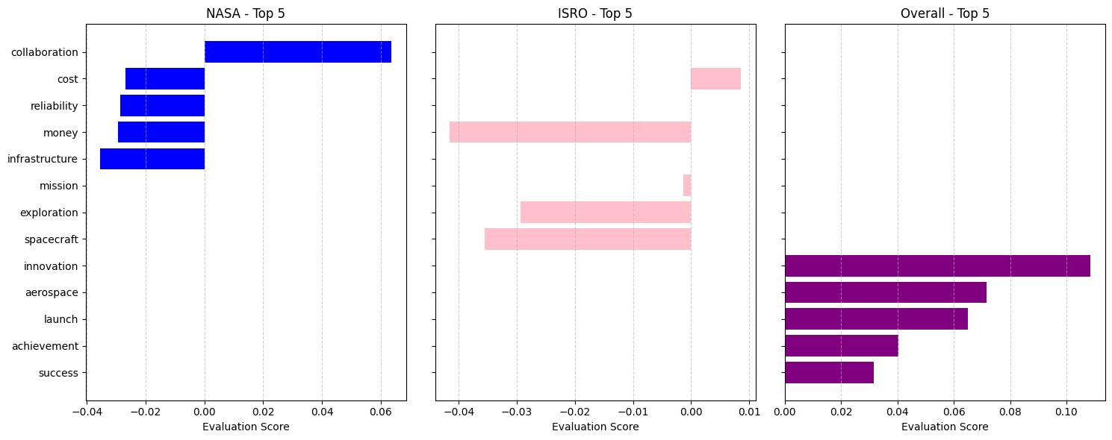
Evaluation Scores
Notes:
Evaluation score: product of spacy similarity score and normalized BERT from -1 to 1, where -1 is extremely negative and 1 is extremely positive
ISRO has negative spacecraft sentiment because they have to outsource their production to the private sector instead of making themselves
Comments include stuff from before the time of Chandrayaan and Pragyan, which made ISRO more visible to the eyes of the public
Evaluation Analysis:
NASA: Collaboration and cost-efficiency (wasting money) are the most visible attributes in the evaluation score for NASA.
ISRO: Mission and cost-efficiency stand out for ISRO in the evaluation analysis.
Overall: Cost-efficiency and reliability emerge as key visible factors across agencies.
NASA:
The top 5 attributes for NASA based on evaluation scores include collaboration, cost, reliability, money, and infrastructure. These scores reflect NASA’s ability to balance a wide range of challenges in space exploration.
Collaboration stands out as the strongest evaluation score, highlighting NASA’s partnerships with other agencies and private companies like SpaceX. This collaboration narrative has been a driving force for NASA’s successes in recent years.
ISRO:
ISRO’s evaluation score attributes are somewhat different, with cost, mission, and exploration scoring higher than others. The relatively high cost score suggests that ISRO’s efficiency in low-cost missions is a widely recognized strength.
However, ISRO's attributes such as reliability and mission have slightly negative or neutral scores, suggesting that while these are areas of focus, the perception might not be as strong or consistent.
Overall:
The overall evaluation score reflects a balanced view of various agencies. ISRO and NASA each excel in distinct areas, with NASA taking the lead in collaboration and reliability while ISRO shines in cost efficiency and exploration.
Collaboration is NASA’s unique strength, while ISRO's emphasis on low-cost missions differentiates it from other agencies. The evaluation score underscores the need for ISRO to improve its perceived reliability to match NASA's stability
Recommendations for ISRO to Improve Visibility:
Promote Innovation and Infrastructure: These are already strengths for ISRO and resonate well with positive sentiment. Continuing to highlight these areas in future campaigns and media could consolidate this position.
Leverage Sustainability: Sustainability is gaining increasing importance globally. Given the growing environmental concerns, emphasizing ISRO's efforts towards sustainable space technologies could capture public interest and align with international goals.
Highlight Exploration and Reliability: While NASA is strongly associated with exploration and reliability, ISRO could benefit from increasing its focus on these attributes, especially given its successful Mars mission and its steady stream of satellite launches.
Increase Communication on Lesser-Discussed Attributes: Attributes like mission and money may not currently be as visible, but increasing discussion about ISRO’s vision, mission objectives, and the financial aspects of their projects could foster greater trust and visibility.
Based on this, ISRO should focus on increasing the visibility of attributes like exploration, reliability, and sustainability, while continuing to promote its strengths in innovation and infrastructure.
Overall Recommendations for ISRO
Leverage Innovation:
Innovation is consistently one of ISRO’s strongest and most positively perceived attributes. Focusing on campaigns that highlight the innovations ISRO has introduced in cost-effective space missions can help further bolster its global reputation.
Improve Perception of Reliability:
ISRO should focus on enhancing its visibility and sentiment around reliability. While it scores decently in innovation, the sentiment around reliability is not as strong. Highlighting successful launch missions and reliable technology implementations will be crucial.
Promote Cost-Effective Missions:
The high evaluation score for cost efficiency is a key differentiator for ISRO. They should continue to emphasize their ability to execute low-cost, high-impact missions, which sets them apart in the competitive space sector.
Increase Focus on Exploration and Collaboration:
NASA dominates the space narrative in terms of exploration and collaboration. ISRO can gain more visibility by promoting its exploration missions, such as Chandrayaan and Mangalyaan, and establishing or promoting existing collaborations with other agencies or private entities.
Enhance Messaging around Sustainability and Resources:
Sustainability is an increasingly critical global concern. Promoting ISRO’s initiatives around resource management and sustainable technology for space exploration could capture the attention of international audiences.

Slide 9

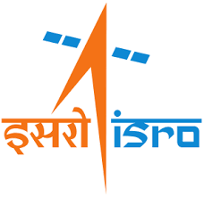
Reddit Comment - Topic Modeling
Space Missions
Key words : camera , budget , make
Global Collaboration
Key words : country, worldwide , science
Space Feed
Key words : orbital, earth, view
Space Missions
Key words : launch , rocket, usage
National Progress
Key words : nation,people,proud
Lunar Achievements
Key words : moon , mission, time
Notes:
NASA Topic 1 : This topic seems to focus on general discussions about NASA and its operations, with emphasis on space-related missions, work being done, budget considerations, and possibly technical aspects like cameras.
Topic 2 :There's a broader focus on international space efforts, science, and global space endeavors, indicated by words like "science," "country," "world," and "want."
Topic 3 :
ISRO : 1. seems to focus on ISRO's space missions, particularly related to launches, rockets,
2.in the context of India and its global standing in space science. The frequent mentions of "india" and "country" suggest discussions on national pride, ISRO’s contribution to India’s technological and scientific growth
3.The words "moon," "mission," and "space" indicate discussions about specific space missions, while "people" and "time" suggest public interest or commentary on the timing and progress of ISRO’s missions.

Slide 10
Discussions where NASA and ISRO are mentioned
Space Missions
Key words : budget, public,mission
Private Sector
Key words : private, better , bridge
Global Efforts
Key words : iss, international , china
Notes:
discussions about the scope of each organization’s missions and the financial aspects of space exploration.also be commentary on India's progress in space via ISRO, compared to NASA.
The words "private" and "better" suggest debates on the role of private companies (e.g., SpaceX) and how either organization is perceived in terms of efficiency or success.
Highlights international collaboration and competition in space exploration, with discussions around the ISS, China’s space efforts, and global space programs.

Slide 11
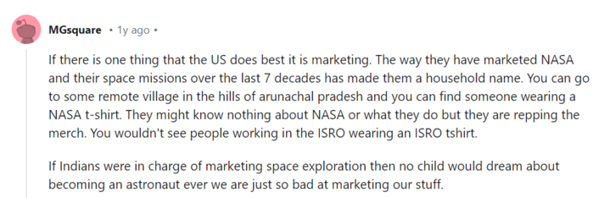
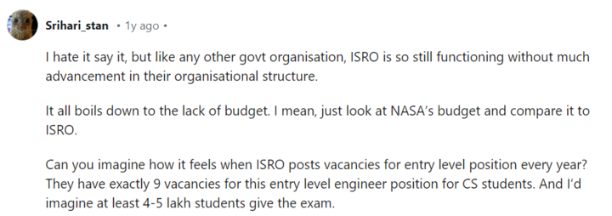
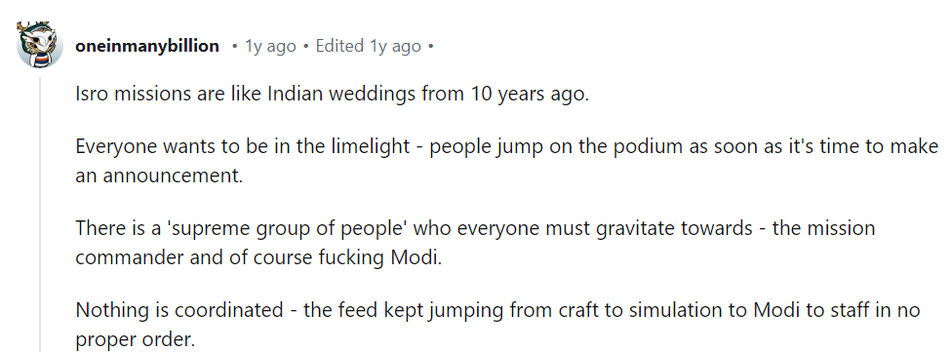
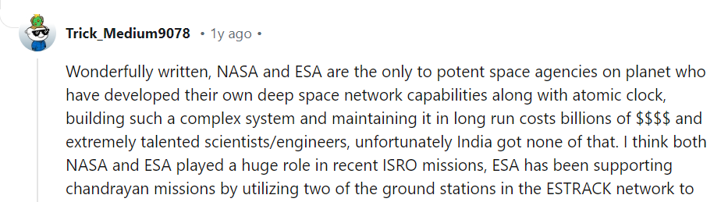
Notes:
For this process: we determined specific words from the frequency counts table and determined if they could provide important insight to the data
We then added context specific words such as “budget” and “cost” based on our knowledge about ISRO and NASA (that ISRO is low budget compared to its NASA counterpart)
For our initial lift calculations, we ran it for all of the scrapped data (including nasa, isro, other indian forums)

Slide 12
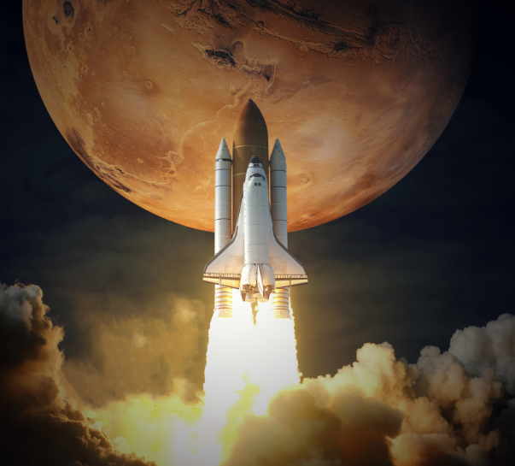
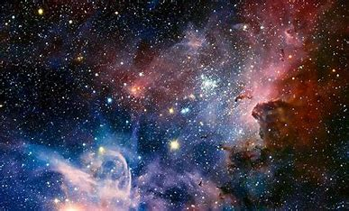
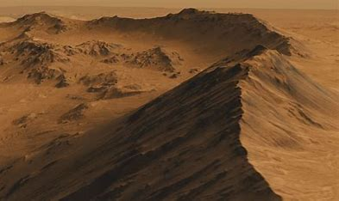

NASA: Instagram Analysis
Space Missions
& Objects
Celestial Bodies
& Sky
Visual Descriptions & Landscapes
Views of Space & Earth
414,101
Avg. likes per image
341,645
Avg. likes per image
771,731
Avg. likes per image
992,279
Avg. likes per image
Prominent Keywords
satellite, view, smoke, rocket, image, air, earth, lake, launching
Prominent Keywords
Large,nasa,picture,object,
sky,close,star,middle,stary ,single
Prominent Keywords
Star,bright,close,sky,galaxy,center, filled,image,blue
Prominent Keywords
View,space,background,close,moon,earth,black,planet, station,white
Notes:
Showing NASA has a Public Relations team

Slide 13
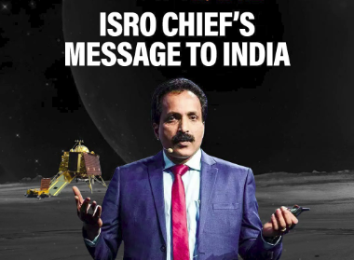
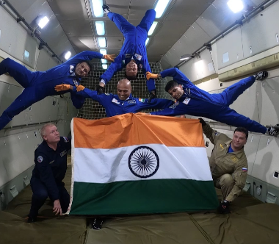
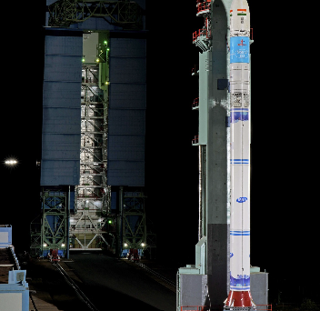
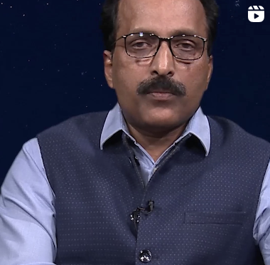
ISRO: Instagram Analysis
Conversations &
Visual Representations
Space Imagery & People
Space Exploration & Technical Scenes
People & Professional Appearance
7,180
Avg. likes per image
10,230
Avg. likes per image
11,842
Avg. likes per image
4,334
Avg. likes per image
Prominent Keywords
quote,space,picture,station,
close,talking,camera.person,star,field
Prominent Keywords
poster,picture,man,message,moon,planet,space,arafed,close,shuttle
Prominent Keywords
background,close,rocket,blue,black,cell,phone,man,logo
Prominent Keywords
man,vest,arafed,glasses,sitting,tie,close,hands,poster,microphone

Slide 14
Image Analytics Insights
ISRO should focus on stunning images of Earth, the Moon, and Mars from their satellites to emotionally engage both Indian and global audiences
ISRO should reduce the emphasis on people and professional appearances, as these posts generate the least engagement

Slide 15
Overall Insights
People are interested in space feed which is highly promoted by Nasa yielding them most engagement
Highlighting ISRO’s achievements on social media can amplify the strong national pride observed among Indian users in comparison to NASA
Notes:
People associating RISK with NASA was an Aha moment - still ambiguous of what they do with funds
People associating Innovation, money, cost and PR
The topics - Space Feed and of missions suggested that NASA actually has a PR team.

Slide 16
Future Steps
Integrate RAG and LLMs: Use Retrieval-Augmented Generation and Large Language Models for real-time insights and deeper comparative analysis.
Predictive Modeling: Forecast public sentiment and trends for upcoming missions like Artemis and Gaganyaan.
Custom LLM Models: Fine-tune LLMs on NASA and ISRO data for accurate mission-level comparisons and reporting.
Notes:
We can do video analytics as well since there are many posts by ISRO that have speech videos. Although the engagement rate for these types of posts is very less but still an analysis can be done on what topics they are discussing and how that can be improved to improve the engagement rate. Duration of the video is also a factor.

Slide 17
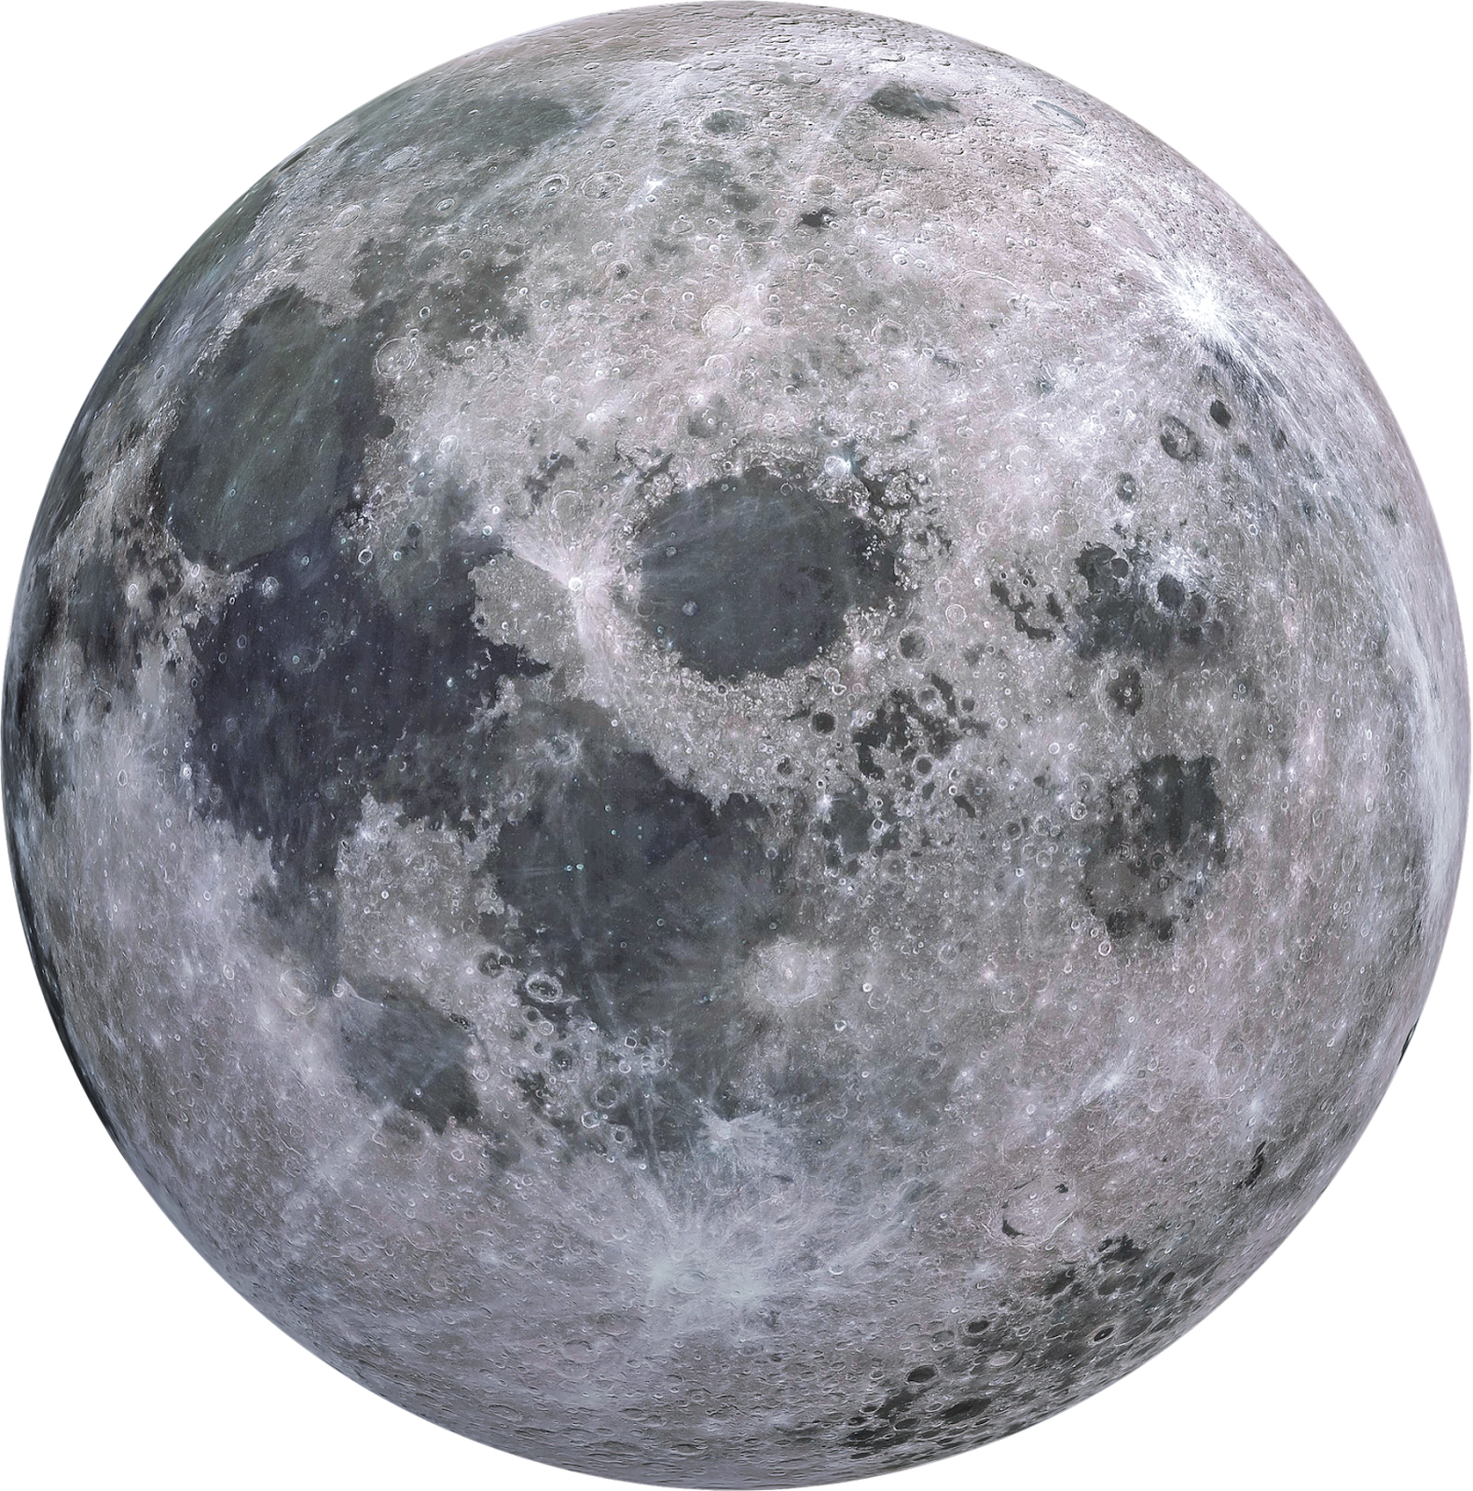
Thank You!

Slide 18
Appendix

Slide 19
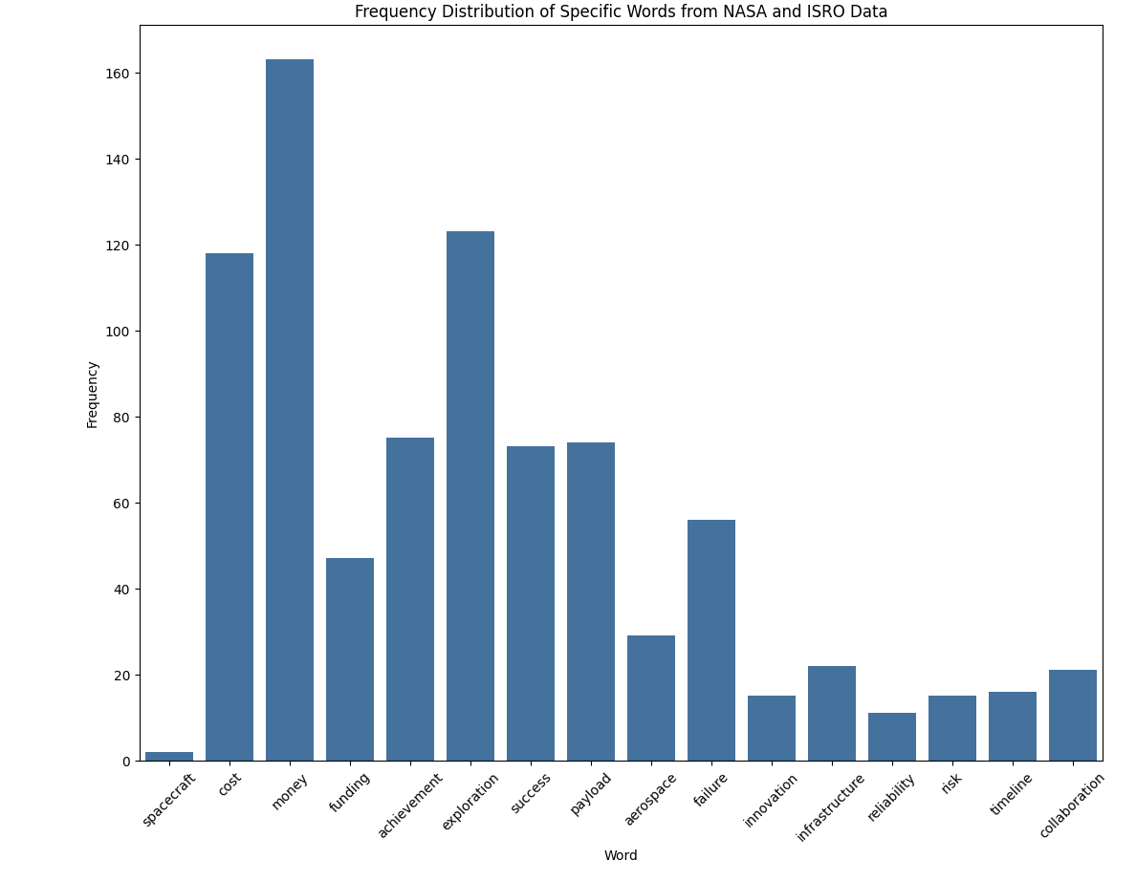
Lift Analysis
Notes:
Before defining the attributes to look at, we analyzed the frequency counts of all words. Then, we defined the following words such as rover, moon, technology to perform a lift analysis.
For this process: we determined specific words from the frequency counts table and determined if they could provide important insight to the data
We then added context specific words such as “budget” and “cost” based on our knowledge about ISRO and NASA (that ISRO is low budget compared to its NASA counterpart)
For our initial lift calculations, we ran it for all of the scrapped data (including nasa, isro, other indian forums)

Slide 20
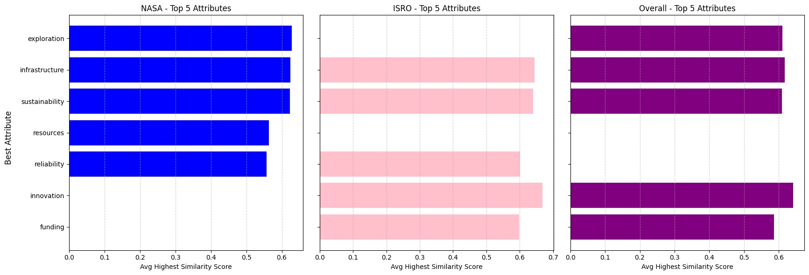
Similarity with SpaCy
Notes:
Similarity Analysis:
NASA: Exploration, infrastructure, and sustainability are most visible and strongly associated with NASA.
ISRO: Innovation, infrastructure, and funding stand out for ISRO.
Overall: Across both agencies, exploration and innovation are consistently visible.
NASA:
NASA's top 5 attributes include exploration, infrastructure, sustainability, resources, and reliability.
The similarity scores for these attributes are tightly grouped, showing that NASA has a strong association with these topics.
Exploration and infrastructure lead the list, indicating NASA’s dominance in missions related to space exploration and technological advancement.
ISRO:
ISRO's top 5 attributes include innovation, infrastructure, funding, exploration, and reliability.
Similarity scores are slightly lower than NASA’s but still indicate a strong association with innovation and infrastructure.
There is a slight gap between innovation and other attributes like funding and exploration, suggesting an opportunity for ISRO to bridge this gap by highlighting its achievements in these areas more.
Overall:
Across all space agencies, attributes such as innovation, exploration, and infrastructure are the most associated.
The visualization shows that these themes are critical for global space visibility, and agencies that excel in them get recognized more frequently.
Attributes such as exploration, infrastructure, and sustainability are the most prominent, with high similarity scores across the visualizations. NASA appears to have focused effectively on these areas, getting significant attention and strong association with these keywords.
Exploration stands out across all sources, indicating NASA's dominant narrative around space exploration.
ISRO's top attributes include innovation, infrastructure, and funding. Notably, ISRO’s focus on innovation seems to align closely with its perceived strengths.
However, the lower sentiment scores for certain attributes compared to NASA suggest that while ISRO’s visibility is strong, there might be room for improvement in how positively these attributes are being perceived.
Attributes like infrastructure and sustainability resonate across both NASA and ISRO, which can be seen as crucial topics across the space industry as a whole. These attributes have relatively high similarity and positive sentiment scores.

Slide 21
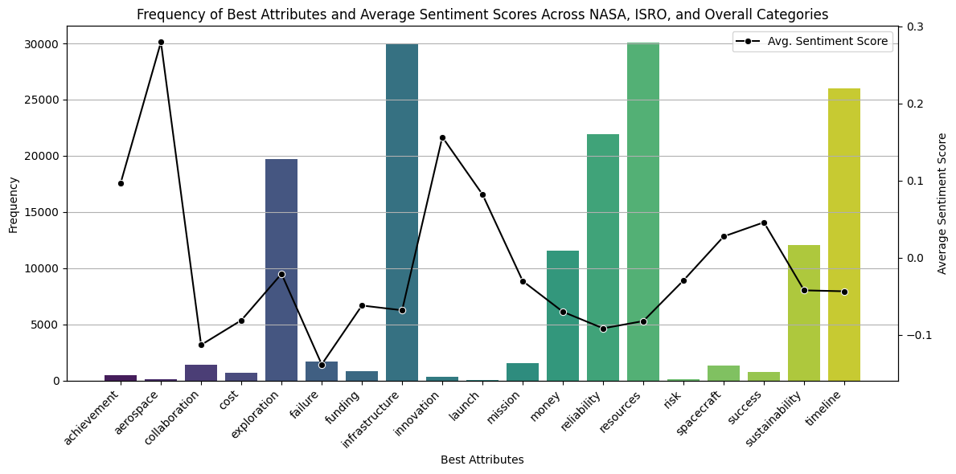
Sentiment Analysis
Notes:
Most frequent attribute for NASA: resources, 46 occurrences
Most frequent attribute for ISRO: infrastructure, 103 occurrences
Most frequent attribute Overall: resources, 574 occurrences
Used BERT because VADER wasn’t properly capturing sarcasm and negative emotions
Sentiment Analysis:
NASA: Reliability and exploration are most positively viewed for NASA.
ISRO: Innovation and cost-efficiency are the most positively perceived attributes.
Overall: Sustainability and infrastructure emerge as highly positive across the board.
NASA:
NASA's best attributes (based on similarity) like exploration, infrastructure, sustainability, and innovation also score well in sentiment analysis. This indicates that not only is NASA strongly associated with these attributes, but they are viewed positively.
Reliability and innovation stand out with high sentiment scores, reinforcing NASA’s reputation for stable, well-engineered missions.
ISRO:
ISRO’s top attributes like innovation and funding have generally positive sentiment scores, with a strong focus on innovation as ISRO’s standout feature.
Although ISRO’s sentiment is positive in many areas, it lacks the same consistency as NASA. However, funding and reliability do show room for improvement.
Overall:
The overall sentiment highlights a positive perception for attributes such as sustainability, infrastructure, and exploration. Sustainability, in particular, stands out as an opportunity for agencies to leverage.
ISRO can potentially improve its sentiment score in areas like reliability and infrastructure by emphasizing achievements in these domains.
Innovation and infrastructure score higher in ISRO’s sentiment analysis. These are strengths for ISRO, and maintaining or even further promoting them could reinforce its brand in the global space narrative.
Sustainability is also a strong topic with overall positive sentiment across NASA and ISRO. There is an opportunity for ISRO to lean into this narrative, especially with the global focus on sustainable practices in various sectors.
Certain attributes, such as mission, money, and risk, appear less frequently but show potential for higher positive sentiment. Promoting these attributes might improve ISRO’s perceived expertise in these critical areas.
Reliability is an area that NASA scores well in, but ISRO has lower visibility. Increasing communication around ISRO's track record, especially in launch reliability, could be beneficial.
Attributes like exploration and spacecraft have strong visibility and positive sentiment for NASA, but ISRO is not as strongly associated with them. Promoting these aspects, particularly given ISRO’s achievements in space exploration, such as the Mars Orbiter Mission, could significantly enhance its profile.

Slide 22
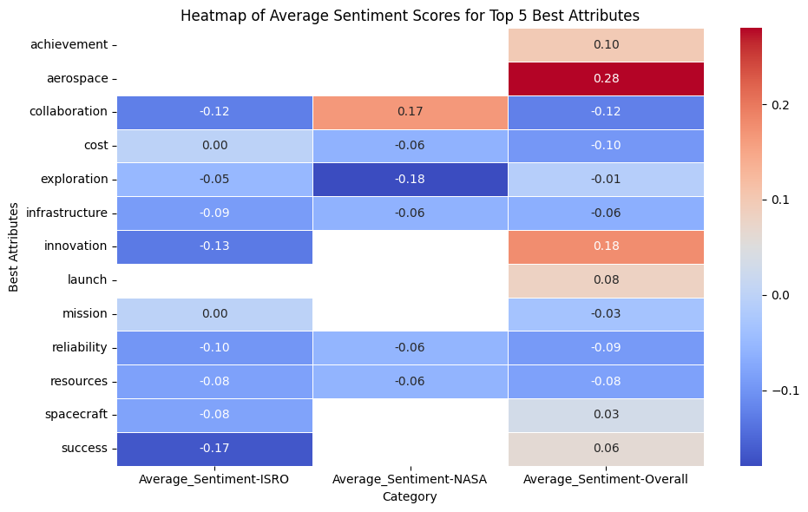
Sentiment Analysis
Notes:
Most frequent attribute for NASA: resources, 46 occurrences
Most frequent attribute for ISRO: infrastructure, 103 occurrences
Most frequent attribute Overall: resources, 574 occurrences
Used BERT because VADER wasn’t properly capturing sarcasm and negative emotions
Sentiment Analysis:
NASA: Reliability and exploration are most positively viewed for NASA.
ISRO: Innovation and cost-efficiency are the most positively perceived attributes.
Overall: Sustainability and infrastructure emerge as highly positive across the board.
NASA:
NASA's best attributes (based on similarity) like exploration, infrastructure, sustainability, and innovation also score well in sentiment analysis. This indicates that not only is NASA strongly associated with these attributes, but they are viewed positively.
Reliability and innovation stand out with high sentiment scores, reinforcing NASA’s reputation for stable, well-engineered missions.
ISRO:
ISRO’s top attributes like innovation and funding have generally positive sentiment scores, with a strong focus on innovation as ISRO’s standout feature.
Although ISRO’s sentiment is positive in many areas, it lacks the same consistency as NASA. However, funding and reliability do show room for improvement.
Overall:
The overall sentiment highlights a positive perception for attributes such as sustainability, infrastructure, and exploration. Sustainability, in particular, stands out as an opportunity for agencies to leverage.
ISRO can potentially improve its sentiment score in areas like reliability and infrastructure by emphasizing achievements in these domains.
Innovation and infrastructure score higher in ISRO’s sentiment analysis. These are strengths for ISRO, and maintaining or even further promoting them could reinforce its brand in the global space narrative.
Sustainability is also a strong topic with overall positive sentiment across NASA and ISRO. There is an opportunity for ISRO to lean into this narrative, especially with the global focus on sustainable practices in various sectors.
Certain attributes, such as mission, money, and risk, appear less frequently but show potential for higher positive sentiment. Promoting these attributes might improve ISRO’s perceived expertise in these critical areas.
Reliability is an area that NASA scores well in, but ISRO has lower visibility. Increasing communication around ISRO's track record, especially in launch reliability, could be beneficial.
Attributes like exploration and spacecraft have strong visibility and positive sentiment for NASA, but ISRO is not as strongly associated with them. Promoting these aspects, particularly given ISRO’s achievements in space exploration, such as the Mars Orbiter Mission, could significantly enhance its profile.

